Slide 1
Writing Drums (UK Garage Example)
- Choose a Tempo (130 bpm)
- Choose a Drum Kit (Roland 909)
- Edit the swing (58%)

Slide 2
Low Drum Part (Kick Drum)
32 step sequencer to make the loop longer and more varied
First half

Slide 3
Mid Part (Clap and snare)
Mid part very simple and in the spaces between the low part notes
Often Mid part focuses around beats 2 and 4 of each bar.
Layered a clap and snare together to create a more interesting sound.

Slide 4
High Part (hi-hat)
Fills a lot of the spaces in between the low and mid parts
Often accentuates the 3rd 16th note of each beat.
Variation of 3 hi-hat sounds to create variation.

Slide 5
Add Bassline
- Choose a bass sound (subby bass)
- Edit the swing (58%)
- Use the rhythm of the kick drum part and add 2 or 3 different pitches (D, C and F)

Slide 6
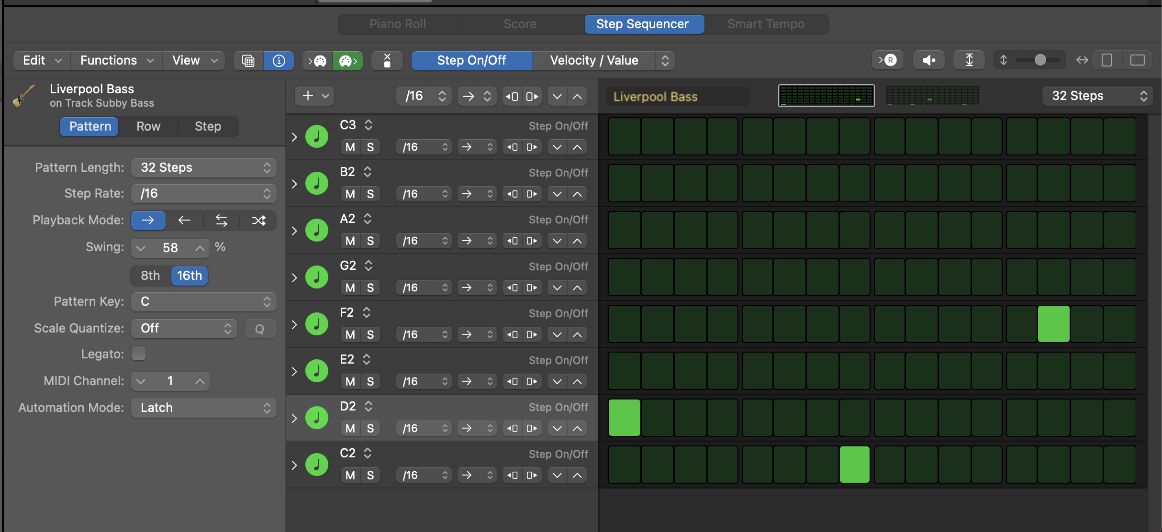
Notice how similar the
Kick (above and bassline (below)
rhythms are.

Slide 7
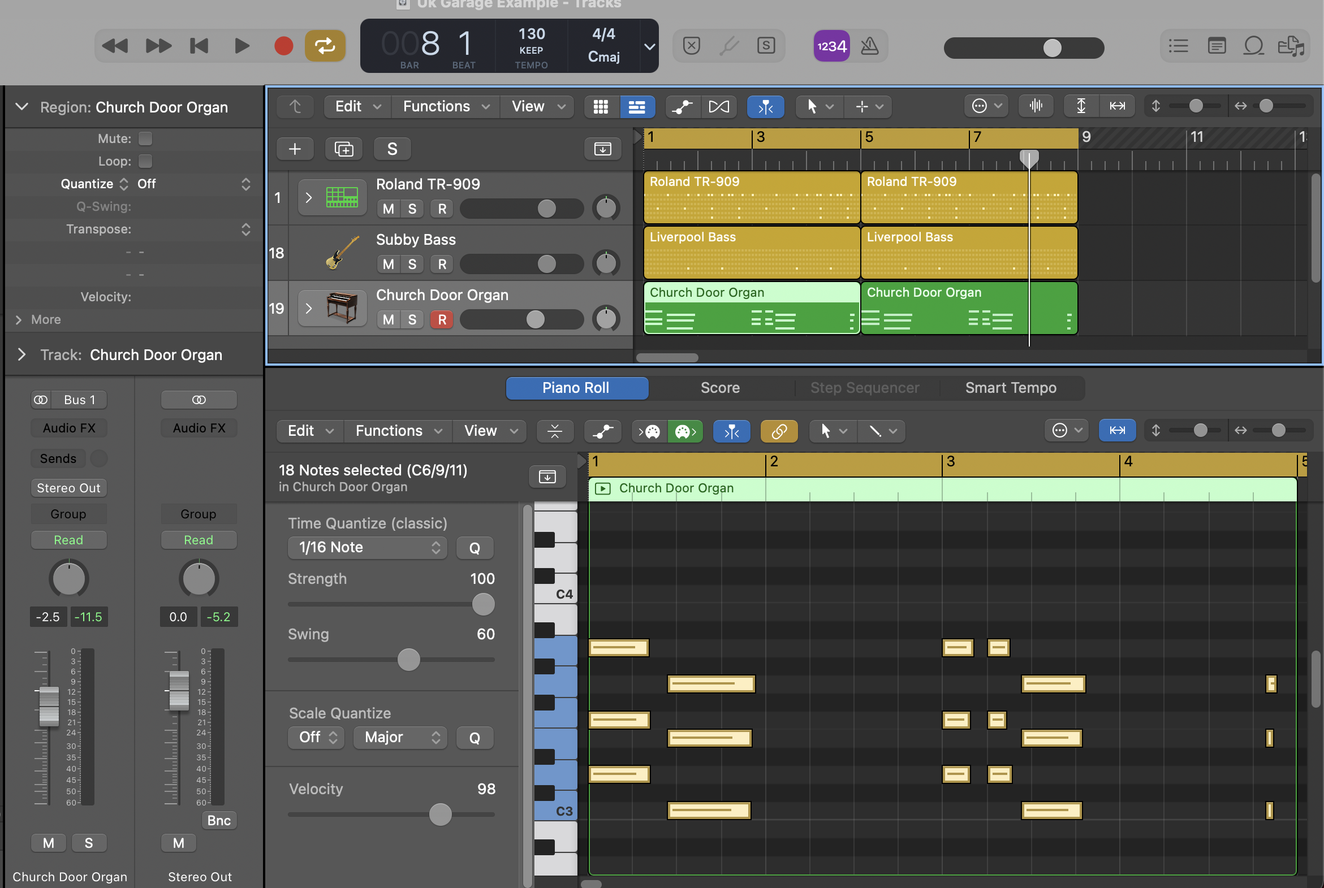
Add Chords
- Choose and instrument (organ)
- decide on chords based on bass notes
In this one D minor (DFA) and C major (CEG)
- Come up with a rhythm which fits with the bassline

Slide 8
Add Melody
- Choose a ‘lead’ sound
- Edit the swing (58%)
- You can use the rhythm of the hi-hat part and add 2 or 3 different pitches (G, A, C)

Slide 9
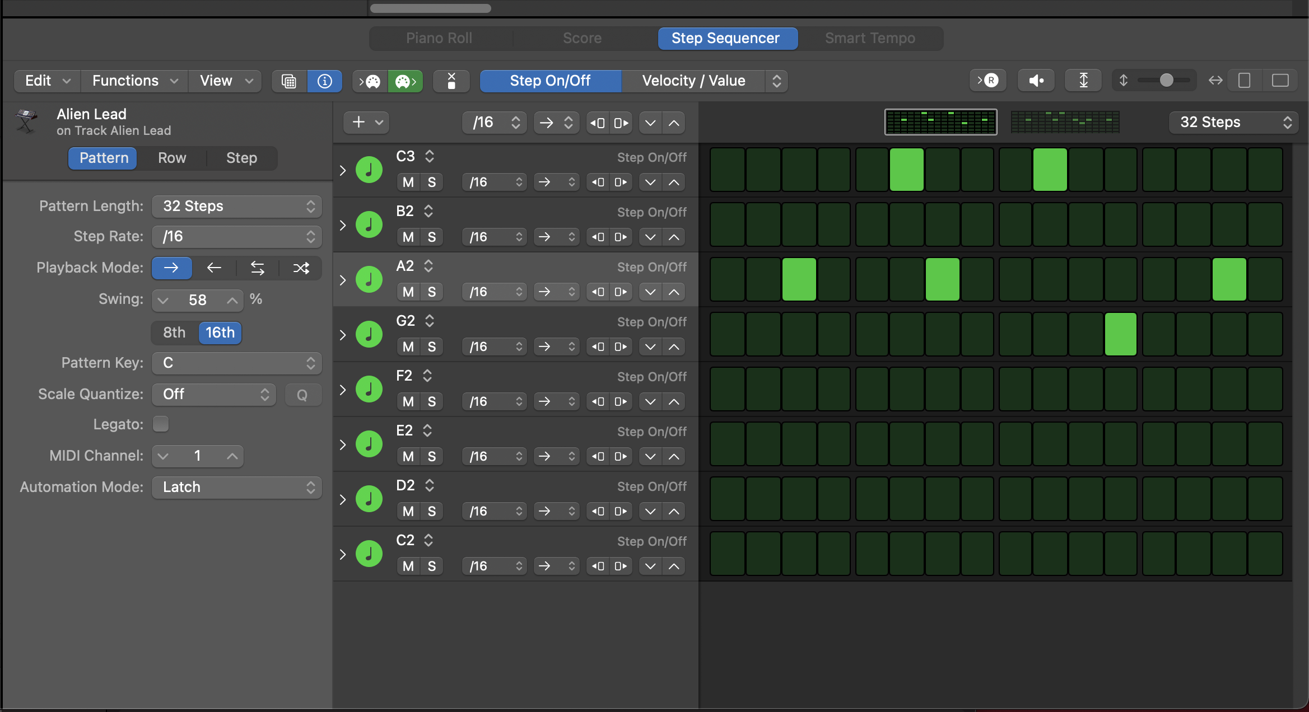
Notice how similar the
Hi-hat (in blue above and melody (below)
rhythms are

Slide 10
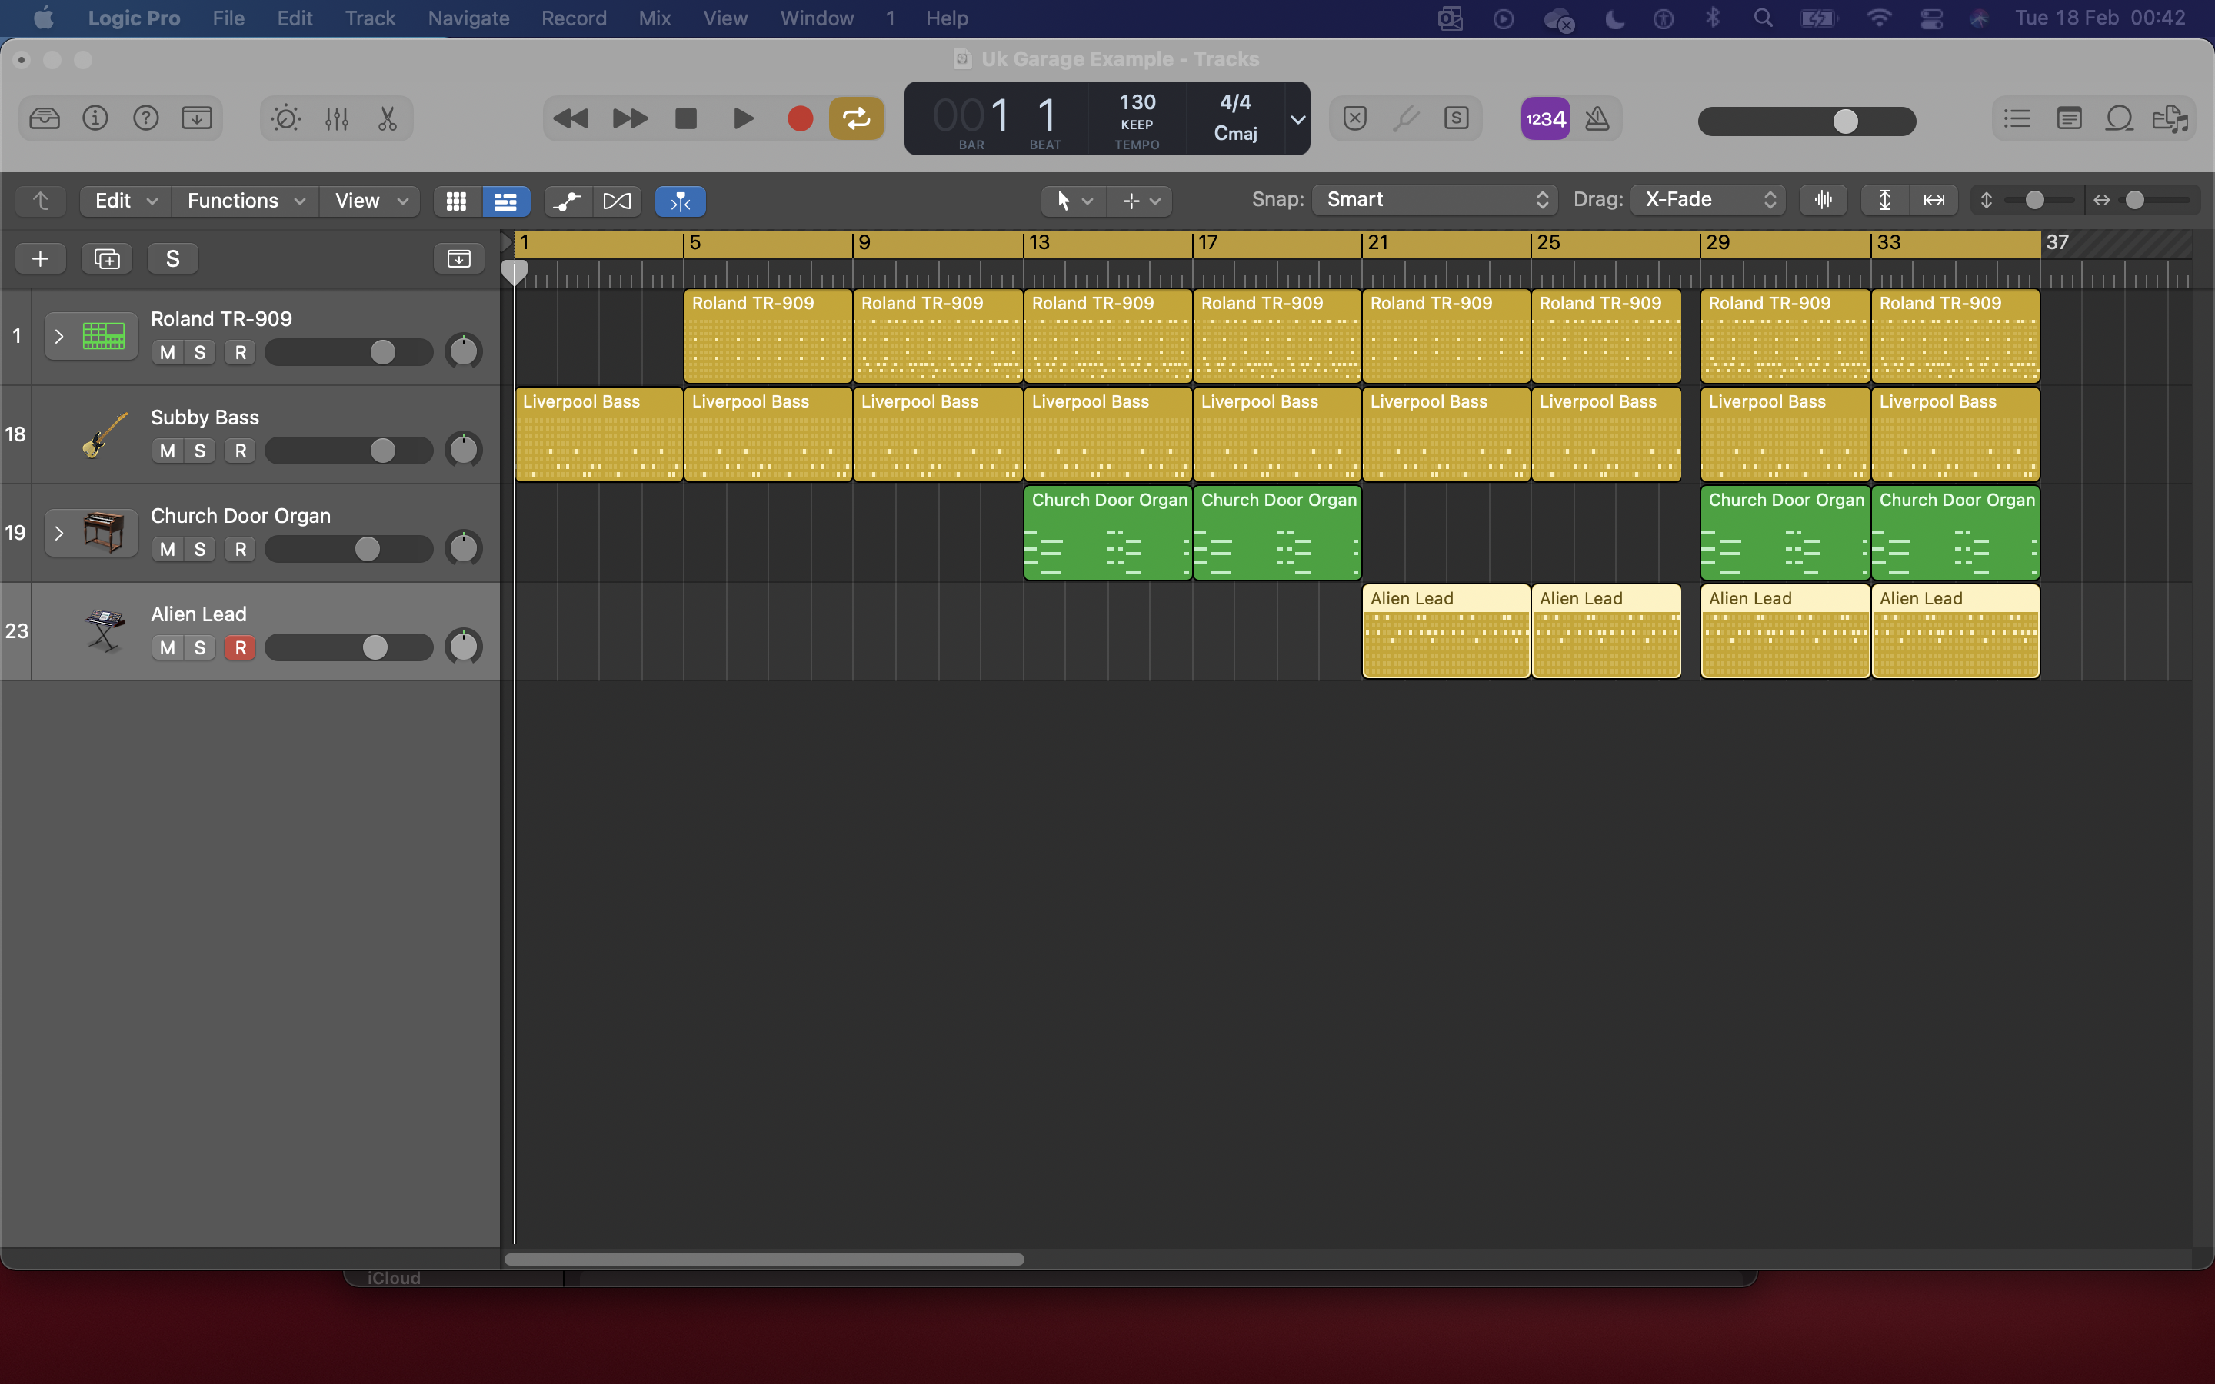
Make a structure
Thinking about varying the texture by adding parts slowly and having different combinations.
Use of separate drum parts rather than always having low, mid and high parts
Think about the vocals, which parts need more musical elements and which sound better with less going on?
Can you write a new musical section if there’s a chance in the story/mood of the words?

